Slide 1
Overview Workshop

Slide 2
Purpose & Learning Objectives
Purpose:
To provide explicit knowledge of the Strategy Deployment process and architecture. This training is provided virtually in order to better utilize team members’ time and schedule.
Learning Objectives:
Participants should gain a basic understanding of the Strategy Deployment process and architecture, mechanics, philosophy, and terminology, as well as its importance to all stakeholders within the company.

Slide 3

What is Strategy Deployment
- and What it is NOT!

Slide 4
Interesting Statistics Regarding Strategy

Slide 5
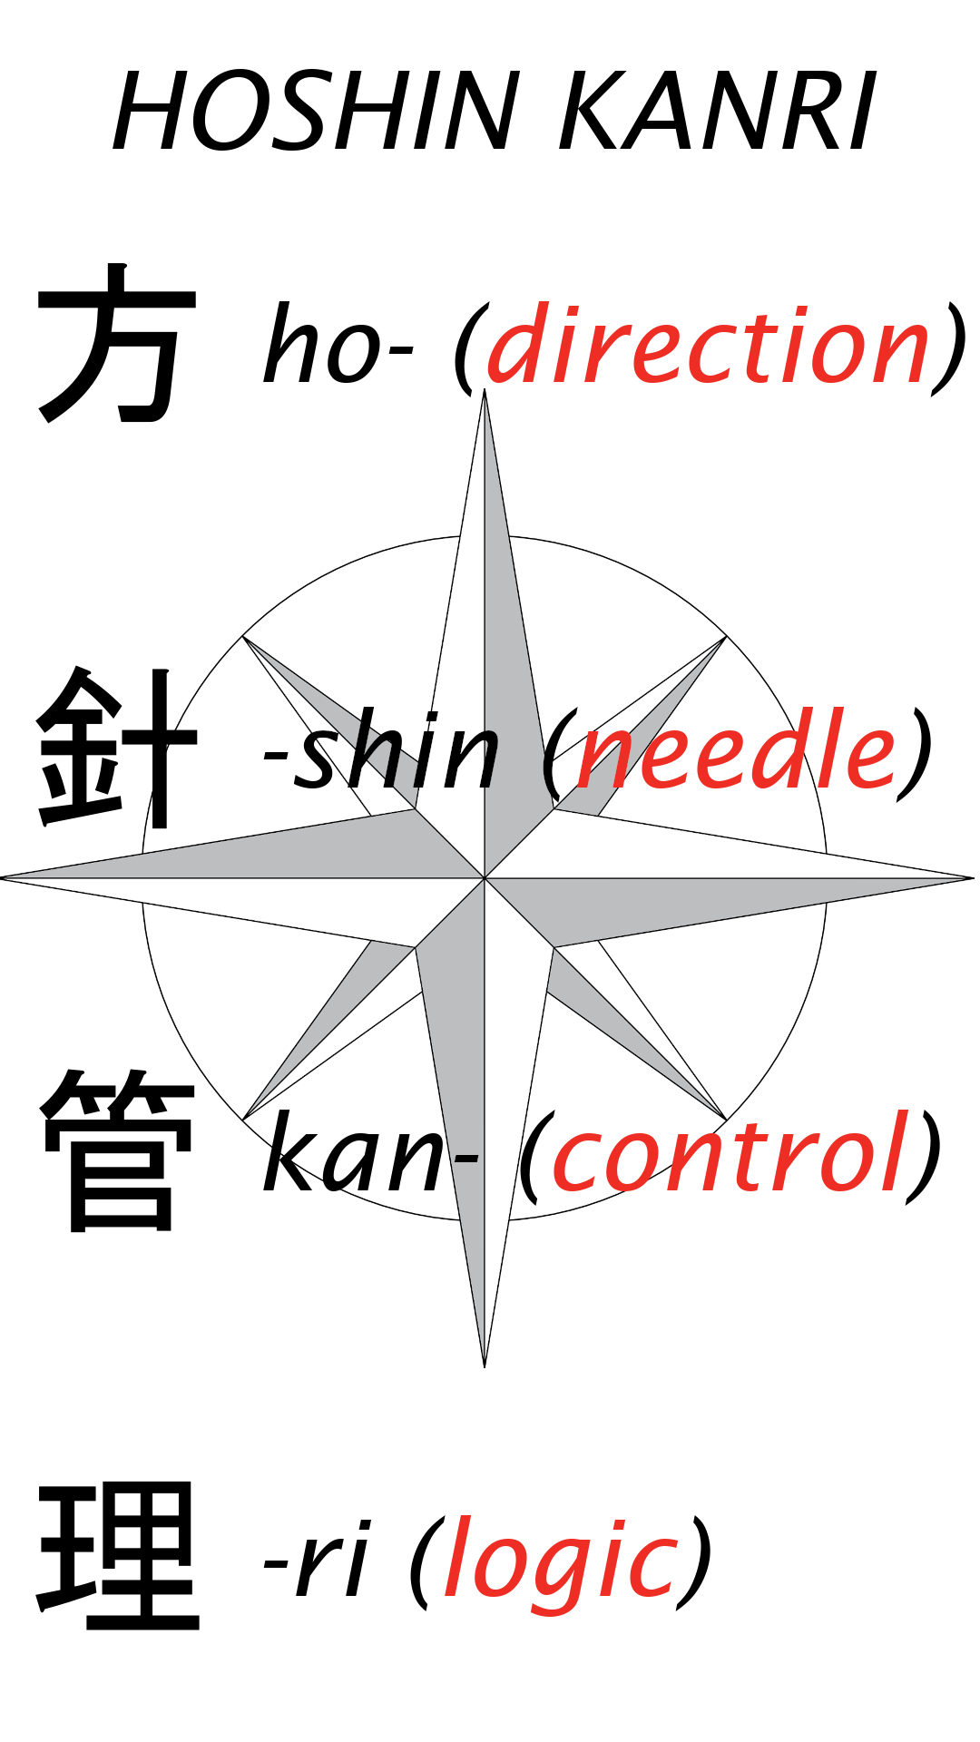
What is This Called? - Many Names…
Strategy Deployment Kanri
Strategy Deployment Planning
Strategy Deployment
Policy Deployment
Goal Deployment (DO NOT USE THIS!)
Etc.
Disciplined Process to Achieve Sustainable, Profitable Growth

Slide 6
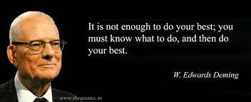
What is Strategy Deployment?
A logical, three-year plan with one-year components
Drives breakthrough (stretch) performance levels
Aligns valuable resources within the company
“Operationalizes” strategy by linking to tactics
Integrated performance review process (PDCA)
Results in specific action plans—Not discussion
Facilitates communication of the right vision
Deciding on what NOT to do is as important as deciding what to do!

Slide 7
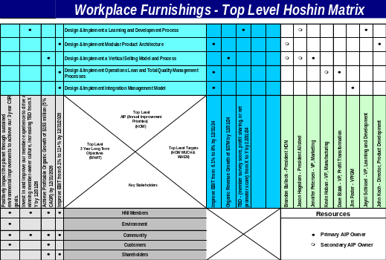
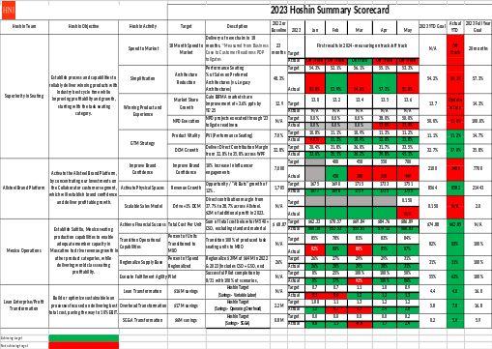
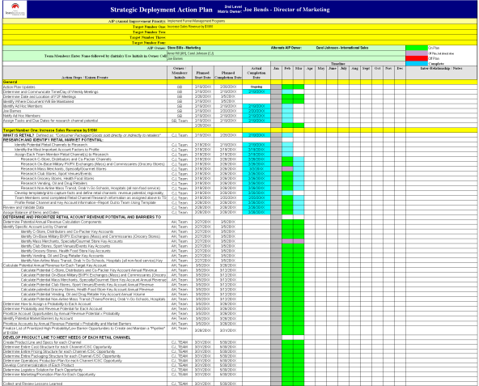
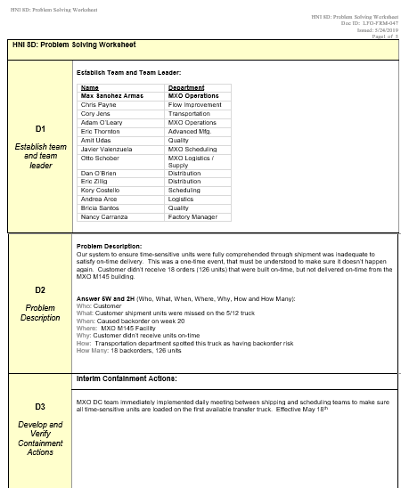
The Forms of Strategy Deployment
Strategy Deployment Matrix
Strategy Deployment Bowling Chart
PLAN
CHECK
Action Plan
8D - Countermeasure Form
DO
ACT
QUESTION: Is your Strategy Deployment a “Form-Filling” Exercise?
Notes:
Lines the tools of SD with PDCA
Stress that there is overlap, but generally the matrix is about planning, the action plan about doing, the bowling chart about checking, and the A3 about acting when off course

Slide 8
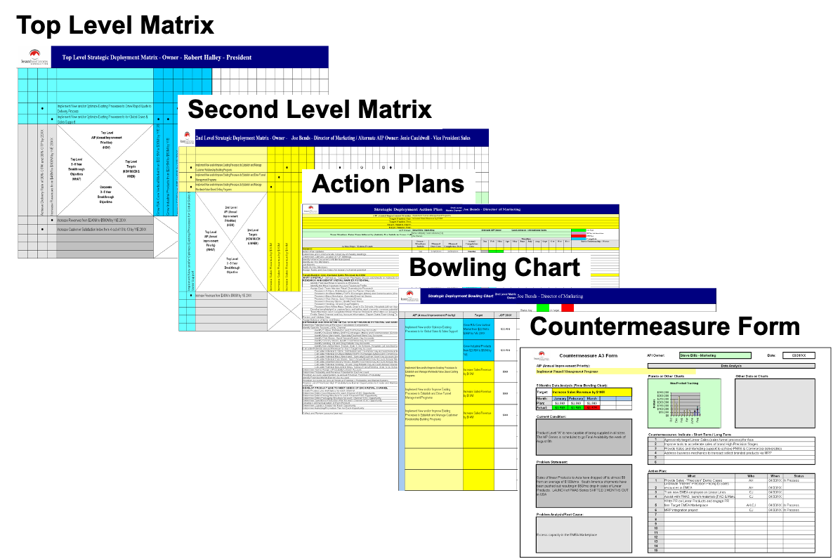
Strategy Deployment is Not Long-Range Planning!
Strategy Deployment is a Means to Make Your Long Range Plan a Reality
Strategy Deployment Process
Strategy
Strategy Must Describe: What game are we playing and how are we going to win?
Notes:
DO: Use this analogy and stress the common error that many companies make during Strategic Deployment.

Slide 9
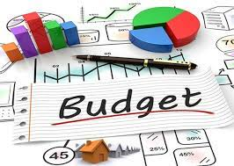

Budgets and Strategy Deployment
Do Not Use Strategy Deployment to Implement Your Budget
Strategy Deployment
BUDGET/FINANCIAL PLAN
Budgets are NOT Breakthrough!
Notes:
DO: Use this analogy and stress the common error that many companies make during Strategic Deployment.

Slide 10



How to Think About Strategy Deployment
When building a house, which would you do first?
Hire an Architect? – Long-Range Plan
Hire a General Contractor? – Strategy Deployment Process
Hire Skilled Tradesmen? – Targeted CI Tools
Strategy Deployment turns your Strategy into reality!
Notes:
DO: Use this analogy and stress the common error that many companies make during Strategic Deployment.

Slide 11

7 Phases of the Strategy Deployment Process
Based on the Deming Cycle - PDCA
Develop Strategy
Plan
Develop Breakthrough Objectives
Catchball
Do
Check
Act
Develop AIPs, Targets, Resources
Deploy AIPs
Targeted
CI Efforts
Counter-
measures
Implement AIPs
Monthly PDCA Review
Annual Review
QUESTION: Where could be the failure point in your organization?
Notes:
DO: BREIFLY walk the group through this chart noting that you will be taking them through each step in the process in great detail. Key points to stress:
Strategic Deployment is a PROCESS.
The SD process is mirrored after the PDCA cycle.
You must do ALL of the steps to be successful.
Most companies fail by not implementing steps 5 & 6.
Just because you “Planned” does not mean you did SD.
Note the considerable amount of steps in “Plan” vs. other steps. This is typically a Japanese philosophy where they will spend more time in Planning and a small amount of time in the execution (DO) stage. This is sometimes the opposite thinking of traditional Western management.
SAY: “This cycle is based on the Deming Cycle, or the Plan-Do-Check-Act cycle. When leading with Strategic Deployment your business and its processes will continuously be at different points of implementing this cycle. Notice that it is a cycle (and there are cycles within the cycle) because continuous improvement never ends.

Slide 12
The Complexion of Strategy Deployment
Typical Maturity Timeline - With Aggressive Adoption of Lean
OPERATIONS
SQDC
PROFITABLE
GROWTH
----- HYBRID -----
0 - 2 Years
1 - 3 Years
3+ Years
You must earn the right to grow!
Notes:
DO: Use this analogy and stress the common error that many companies make during Strategic Deployment.

Slide 13

What is Catchball
- and WHY is it important?

Slide 14

Catchball Defined
An approach to decision-making where ideas are pitched from one individual to another to improve them iteratively.
The object is to secure the best approach when implementing Strategy Deployment.
A technique to maintain open feedback within a company’s hierarchy, both vertical and horizontal.

Slide 15

Catchball Importance
Improves buy-in and engagement of members within the Strategy Deployment architecture.
Facilitates input from various areas of the company.
Allows all concerned to provide their input.
Assures mutual understanding of the goals and objectives of the company.
Decreased barriers to cross-functional collaboration.
Clarity of ownership and accountability.
Alignment of goals and objectives.

Slide 16

How does Strategy Deployment differ from
Daily Management?

Slide 17
The Most Common Pitfall:
Confusing Strategy Deployment with Daily Management
Criteria | Strategy Deployment | Daily Management
Focus | ON the business | IN the business
People/Teams | Multi-Functional | Functional
Initiatives | Strategic | Tactical
Scope | Narrow & Deep | Wide/Across Enterprise
Metrics | Few - Strategic | Many - KPIs
Improvement | Breakthrough | Incremental
Financial | Beyond Budget | Budget
Involvement | Select Few | All
Kaizen Resource Allocation | 70% | 30%
Review Cycle | Weekly/Monthly | Hourly/Daily
Management Focus | Senior | Middle & Below
QUESTION: Are you confusing Strategy Deployment with Daily Management?

Slide 18

What are Breakthrough Objectives, and why are they important when establishing your Strategy?

Slide 19

Long-Term (Breakthrough) Objectives - Checklist
Are Long-Term (Breakthrough) Objectives…
Significant benefit to the organization?
Tied to the Strat Plan?
Customer-focused?
Truly Stretch?
Enlisting cross-functional involvement?
Resulting in a new system or new way of doing business?
Not already learned? (Do we already know how to do it?)

Slide 20
Breakthrough Examples
Financial
Achieve upper quartile financial performance as compared to peer companies from $X EBITA to $Y EBITA by FY20XX
Achieve RONA from X% to Y% by 11/30/XX
Generate cash flow from 0.7% to 1.2% of earnings by FY20XX
Strategic and Growth
Examples
Profitable Growth
Improve revenue from Systems Sales from $X to $Y by 9/30/XX
Achieve market share in Motion Controls Market from 28% to 60% by FY20XX
Operational
Reduce internal quality rejects from 85,000 parts per million to 2,000 parts per million by 10/31/XX
Improve Customer Satisfaction index from 60 to 98 by FY20XX

Slide 21
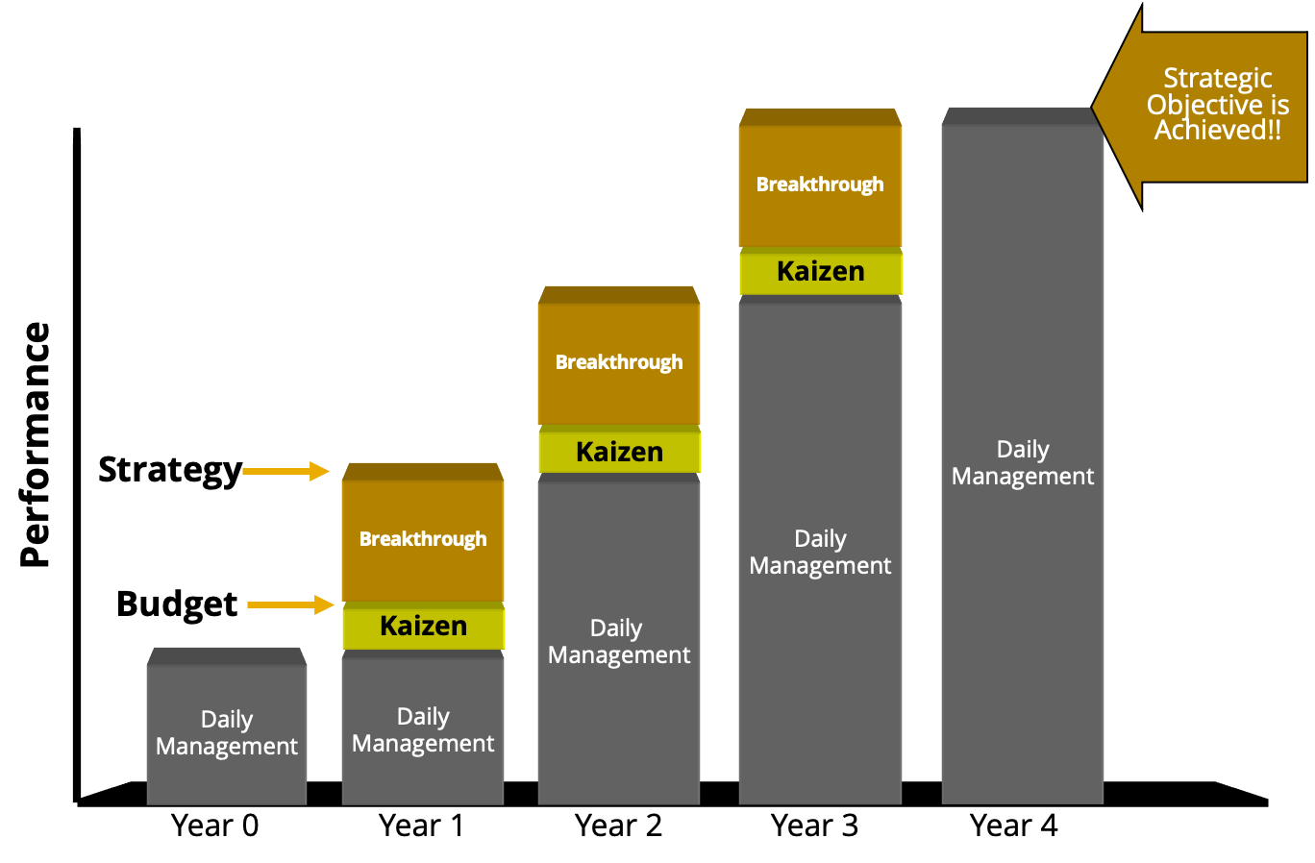

Breakthrough Thinking
Strategy Deployment Objective is Achieved
Strategy Deployment Targets
Strategy Deployment Targets
Strategy Deployment Targets
QUESTION: Are you using Strategy Deployment to achieve your financial budget, or BREAKTHROUGH performance?

Slide 22

What is the difference between LEADING and LAGGING indicators?
Why are they both important?

Slide 23





MEASUREMENTS
KPIs: Leading vs. Lagging Indicators
Leading Indicators
Lagging Indicator
Exercise
Calories
Nutrition
Sleep
How do your KPIs Measure Up?

Slide 24




MEASUREMENTS
KPIs: Leading vs. Lagging Indicators
Leading Indicators
Lagging Indicator
Near Miss
PPE Violations
Lost Time Incidents
Unsafe Practices
Manufacturing Examples

Slide 25
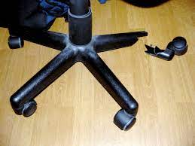



MEASUREMENTS
KPIs: Leading vs. Lagging Indicators
Leading Indicators
Lagging Indicator
Quality KPIs
Poor Branding
Quote Win Rate
Long Lead-Times
Commercial Examples

Slide 26

Why should CI efforts be aligned to Strategy Deployment?
To what degree?

Slide 27
Strategy Deployment Case Study - JAKE Brake
Strategy
Achieve Market Share Objectives by becoming counter-cyclical
3-Year Breakthrough
Objective
Penetrate Asian Market to Achieve $XXX of Profitable Revenue
Annual Improvement
Priority/Target
Design & Implement a New Product Development Process
  Reduce NPD Leadtime from 72 months to 18 months
Value Stream Focus
Engine Lab - Dyno Testing Process
Targeted Kaizen Focus
Single Minute Exchange of Dies
  Reduced Changeover Time from 21 Days to 1 Day
QUESTION: Are your Lean initiatives targeted towards your strategic imperatives?
Notes:
DO: State how this case study maps back to the model.
This example highlights the key elements of Strategic Deployment:
Strategy
Strategic Breakthrough Objectives
Annual Improvement Priorities
Targets
In this example, one of the most critical value streams in New Product Development was determined to be the Engine Lab Testing. Within that value stream changeover time was identified as waste and thus attacked. Notice the Pareto chart thinking to ‘drill down’ into the opportunity. Also notice how Lean approaches can be linked with changing ‘how’ we run our business.
Important to note here is that the Lean tool (SMED) was chosen AFTER the business objectives were determined. Lean tools should not be implemented without a business purpose. Also stress that SD can help us understand which value streams are strategic. Not all value streams should receive the same time and attention due to their strategic significance to the organization.
DO: Ask the participants if they can also provide a case study/example within their own organizations?

Slide 28

Why do CI efforts need to be enterprise-wide?

Slide 29
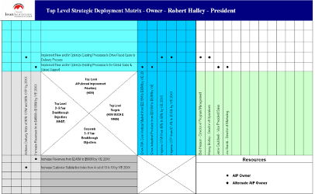
Strategy Deployment Case Study - JAKE Brake
President
Manufacturing
Sales
Engineering
Finance
President
Manufacturing
Sales
Engineering
Finance
If you seek to optimize any given function, you will suboptimize the enterprise.

Slide 30

What is the role of Leadership?

Slide 31


The Role of Leadership in a Strategy Deployment Environment
Top Mgt.
Strategy Deployment
Initiatives
Not everyone gets to work on Strategy Deployment.
Someone has to run the business!
But everyone gets to do Continuous Improvement!
Middle Mgt.
Continuous
Improvement
Supervisor
Daily Management
Front Line
Associate
Fire Fighting lives here!
Appropriate Use Of Available Time
QUESTION: Are you working IN the business or are you working ON the business?
Notes:
DO: Remind the participants what is meant by “kaizen” (just in case).
ASK: “What is this chart telling you?”
SAY: “Key points to consider:
We want senior management to spend most of their time on strategic breakthroughs, NOT on daily management.
Kaizening daily management is critical if we are to free up our time to work on breakthrough.
Note that Front Line associates spend more of their time executing the work (working IN the business) within existing daily management processes.”

Slide 32
PDCA Monthly Review – Role of Leaders
Conduct lively Strategy Deployment PDCA sessions that test members’ understanding.
Do not try to solve the team’s issues:
  Assure they understand the situation (with data).
  Assure there are no resource conflicts.
Evaluate the effectiveness of specific projects and Action Plans.
Evaluate the effectiveness of the overall improvement process.
Decide when to take action and what type of action to take.

Slide 33
Monthly Strategy Deployment PDCA Review
– Questions Leaders Should Ask
Are targets being met with sustainable business processes?
Will good results be sustainable in the future?
What are the processes that are achieving results?
What are the processes that are not achieving good results?
What are the causes of the bad results?
Are there adequate resources assigned to Strategy Deployment projects?
Is the improvement process inadequate?
Are you creating a learning organization and culture?

Slide 34

What are Strategy Deployment Pitfalls and Success Factors?

Slide 35


A Word of
It’s not about the forms or X-Matrix.
Forms are not magic - thinking is required!
Failure to see the Strategy Deployment process all the way through the PDCA cycle will result in some pretty impressive wallpaper.
A waste of your time, your team’s time, and their hopes for a more respectful environment!

Slide 36

Strategy Deployment Pitfalls
Doing too much – you must make a conscious decision as to what you are NOT going to do
Not divorcing Daily Management KPIs vs. Strategy Deployment Objectives
Leadership insisting on giving answers rather than asking the right questions
Leaders developing the plan in isolation without the collaboration of their team
Focus on content – not a form-filling exercise
Inadequate Strategy Deployment architecture
Not driving Strategy Deployment to the Point of Impact
Teams “Plan the Work” but fail to “Work the Plan”
Attempting to grow when operating metrics (SQDC) are underperforming
Attempting to deploy functionally rather than cross-functionally
Failure to build a Root Cause Problem-Solving Culture
Attempting to change the Strategy Deployment process without fully understanding it

Slide 37
Strategy Deployment Success Factors
Strong, hands-on leadership that evaluates progress monthly and demonstrates an on-going interest
Ensuring that Strategy Deployment has the Highest Level of Priority
Requiring the use of the appropriate tools (e.g., 8D problem-solving tools) and root cause analysis
Management applying rigor and discipline to the Strategy Deployment process
Ensuring that the Strategy Deployment AIPs focus on results-oriented processes rather than simply results
Willingness to invest in Member/Management development

Slide 38

What is Strategy Deployment Architecture and why is it important?

Slide 39
Strategy Deployment Architecture
Defined:
The framework that is established to assure focus, accountability, responsibilities, and clarity around all Strategy Deployment activities in order to reach the corporation’s long-term stretch objectives.
Why is it Important?:
Assures accountability and responsibility
Drives Strategy Deployment activities to the “point of impact”
Exposes scope creep and facilitates the “what not to do” discussion
Provides an audit trail back to long-term stretch objectives
Facilitates modifications as a result of PDCA analysis
Provides a framework for management control of resources, Strategy Deployment projects, etc.

Slide 40
Top Level and 2nd Level Strategy Deployments
- Illustrative Example
A company consists of many, many processes.
Most need to be continually improved through the Kaizen process. This is known as Daily Management.
Few key processes are selected to be significantly improved which will strategically provide profitable, competitive advantage. These processes are the focus of Strategy Deployment.
We cannot work on all things, so prioritization is key.
Selected Strategy Deployment processes need to be further broken down into their respective elements in order to focus our improvement efforts. This happens at the 2nd Level of the Strategy Deployment process.
Top Level
Strategy Deployment AIP
Design & Implement a Robust New Product Development Process
Design & Implement a Standardized Parts Management Process
Design & Implement a Stage Gate Management Process
Design & Implement a DFMA Process
Design & Implement a Target Costing Process
Design & Implement a Voice of the Customer Process
2nd Level
Strategy Deployment AIPs
1
2
Targeted Strategy Deployment Processes
3
Daily Management Processes
4
5

